Slide 1
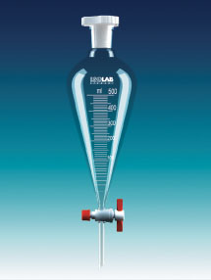

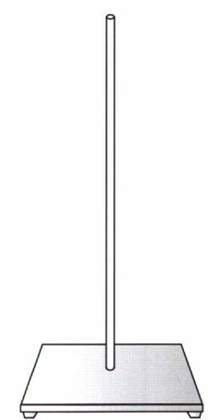

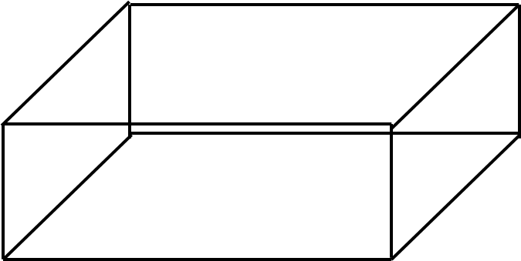

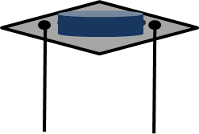
Solution in
Mist out
N₂ in
10Ф

Slide 2
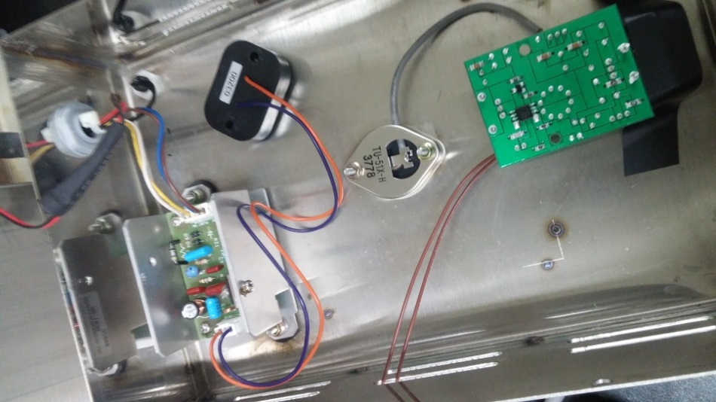
Mist-CVD Ultrasonic
Mist-CVD-(i)
20cm
20cm
<뒷면>
<앞면>
Di Water
10cm

Slide 3
Mist-CVD Ultrasonic
Mist-CVD
10cm
12cm
Glass
20cm
9cm
20cm

Slide 4
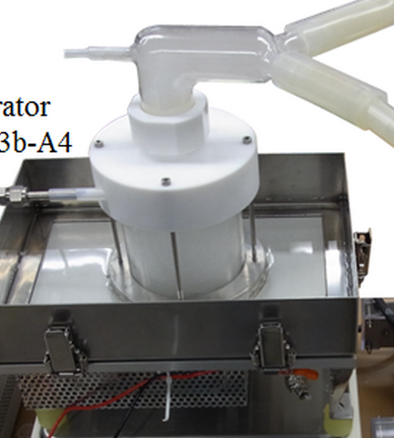
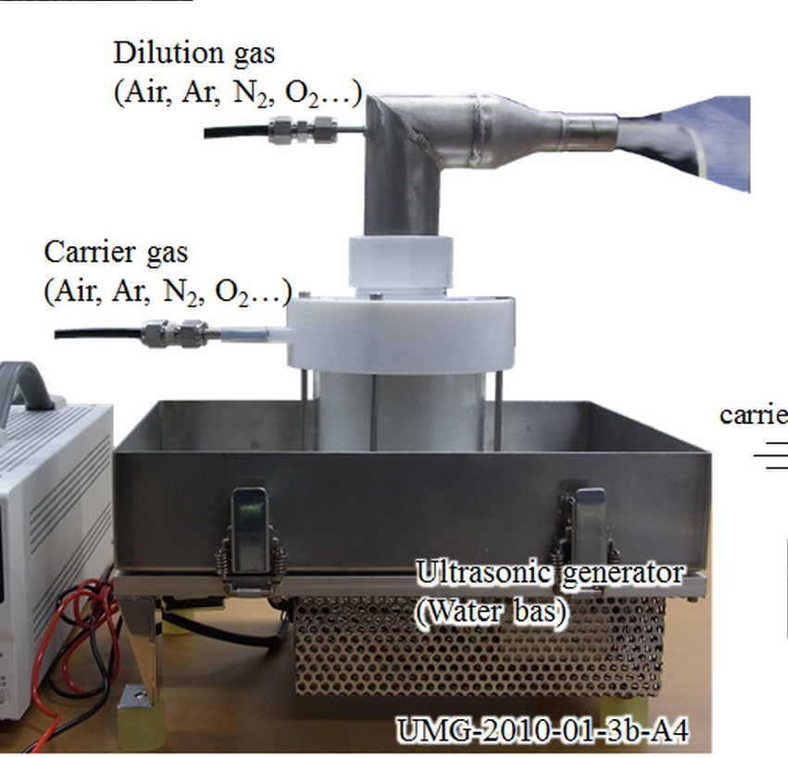
Mist-CVD Ultrasonic– Japan group
Mist-CVD

Slide 5
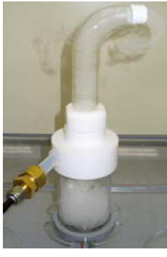
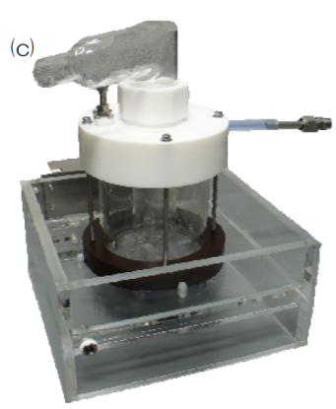
Mist-CVD Ultrasonic– Japan group
Mist-CVD

