Slide 1
Radiation Transmission Measurement
Hyun Joon Choi
Department of Radiation Convergence Engineering
Yonsei University
Republic of Korea

Slide 2
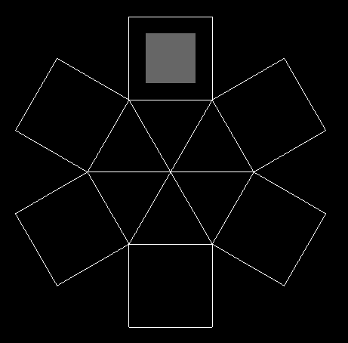
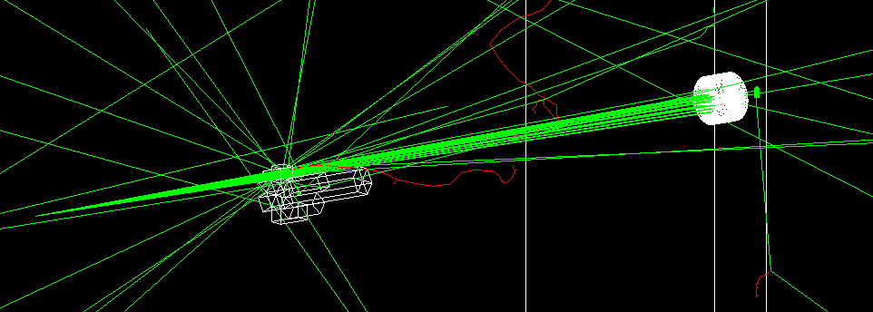
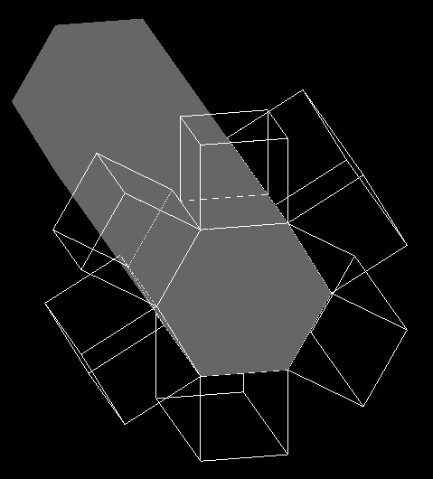
Transmission Measurement
Transmission measurement with propeller shaped attenuator
1
6
2
Radiation Detector
5
3
4
Lead collimator
Divergent beam (Co-60)
Thickness: 1 ~ 50 cm
with 2 cm interval
Rotating Propeller shaped attenuator
5 cm
Rotating

Slide 3
3 cm
3 cm
날개 탈부착 장치

Slide 4
TAHNK YOU
Q & A

